Slide 1
OutfitNet: Fashion Outfit Recommendation with Attention-Based Multiple Instance Learning
WWW2020 By Visa Research

Slide 2
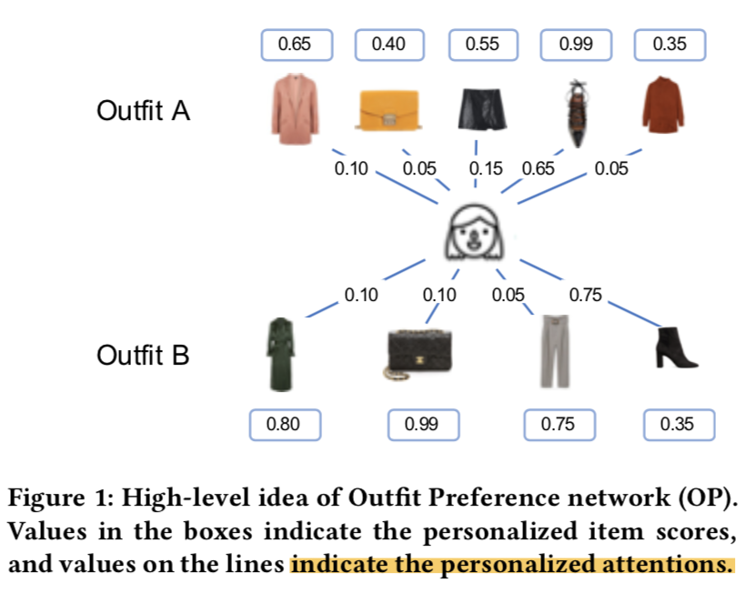
Motivation
一套outfit由多个fashion items组成，用户是否喜欢outfit可能侧重于不同的部分。
不仅考虑单个item的美学，还要考虑item之间是否搭配适宜。
就用户和outfits的关系而言，outfit的数据是稀疏的。
只能知道用户喜欢什么，不知道用户不喜欢什么。(BPR)
OutfitNet：two stages
Fashion Item Relevancy network(FIR): 学习items之间的搭配度并生成items的相关性embedding
Outfit Preference network(OP) : 使用视觉信息学习用户的口味
首先，用户对每个item有自己的偏好
其次，用户对items有不同的权重

Slide 3
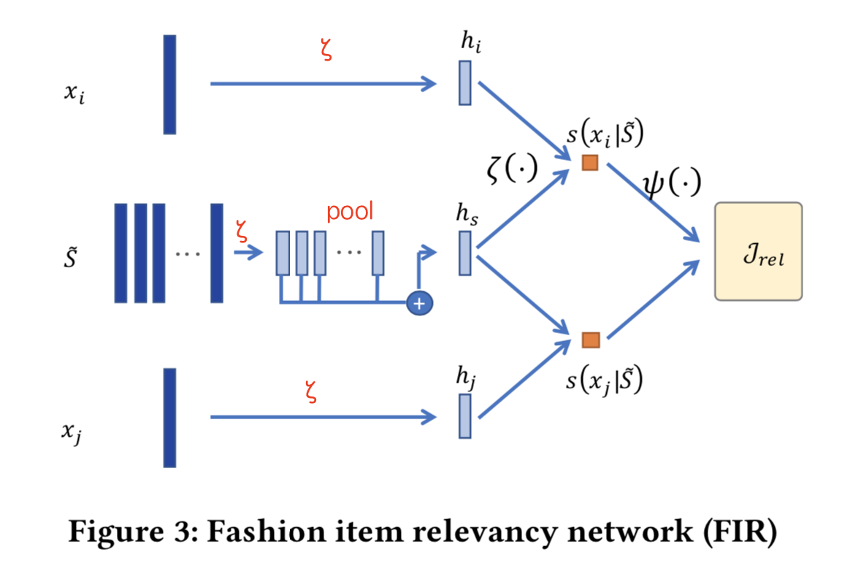
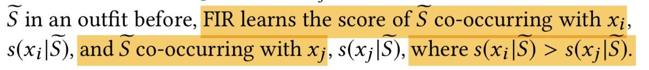
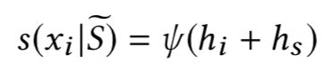
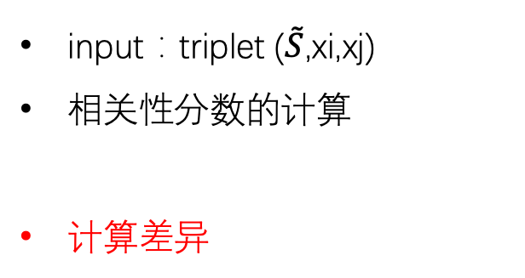
Fashion Item Relevancy Network
The idea is that for fashion items that are more compatible/relevant to each other, they should be closer to each other in the embedding space.
input：triplet ($\tilde{S}$,xi,xj)
相关性分数的计算
计算差异

Slide 4
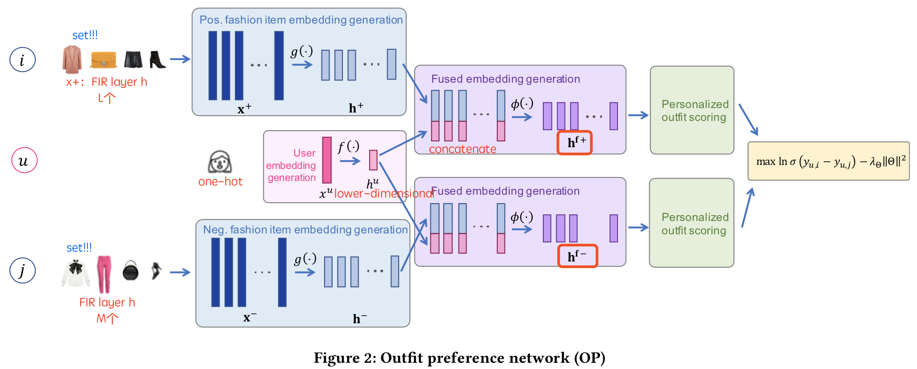
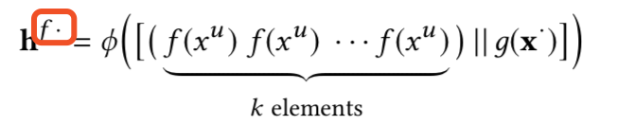
Outfit Preference Network
Pre-processed
Stage 1: Fused Embedding Generation.

Slide 5
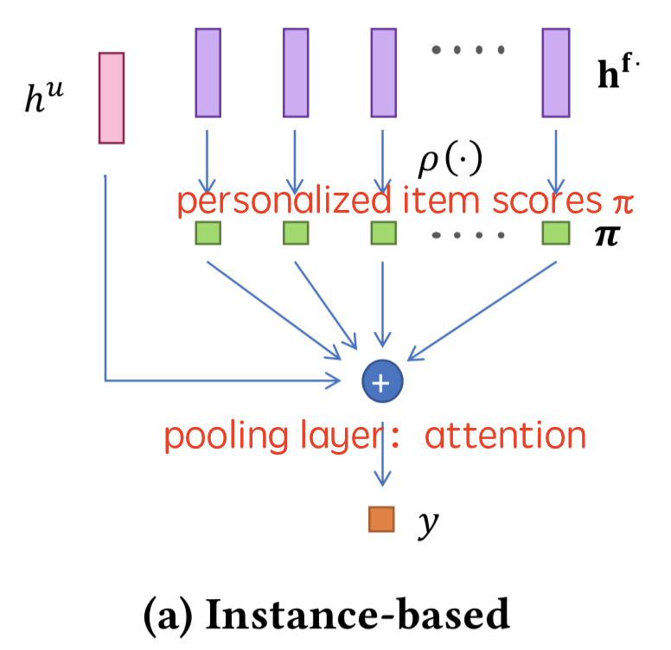
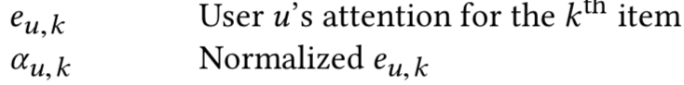
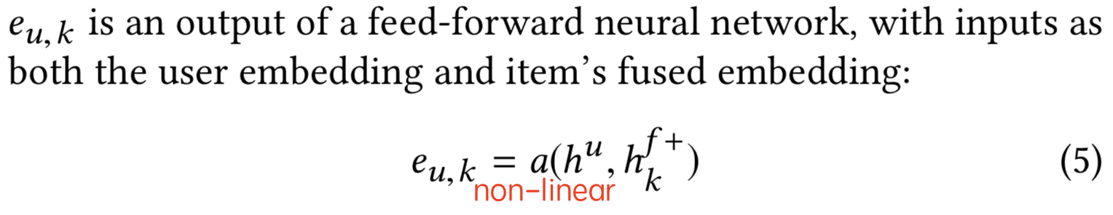
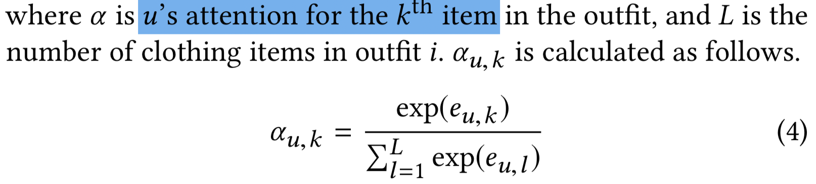
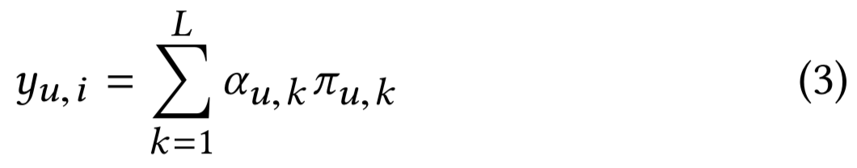
Outfit Preference Network
Stage 2: Personalized Outfit Scoring { Instance-level approach, embedding- level approach }

Slide 6
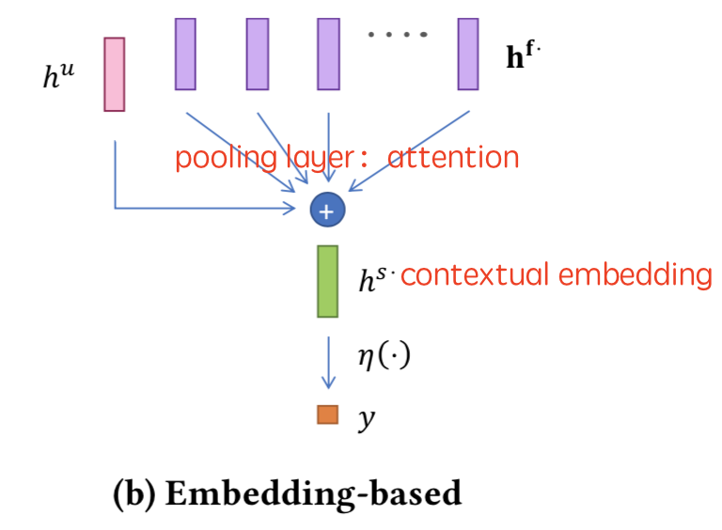
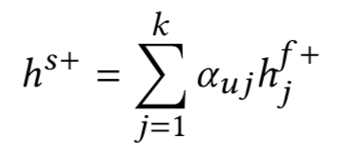
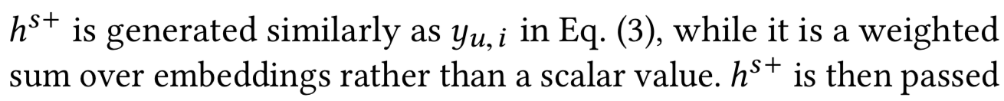
Outfit Preference Network
Stage 2: Personalized Outfit Scoring { Instance-level approach, embedding- level approach }

Slide 7
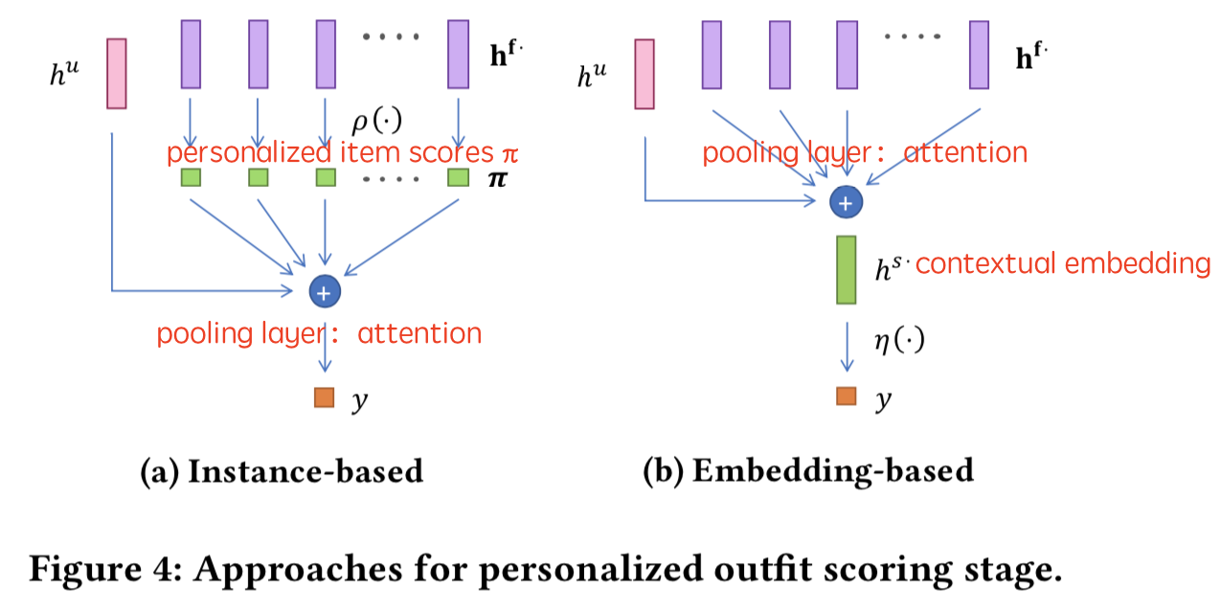
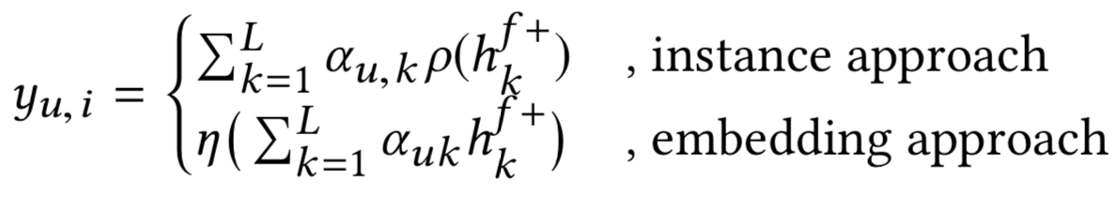
Outfit Preference Network
Stage 2: Personalized Outfit Scoring { Instance-level approach, embedding- level approach }
Attention layer的设计需要注意：
不考虑items的顺序
the attention weights α are personalized

Slide 8
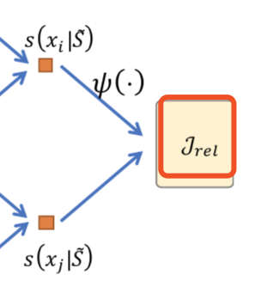
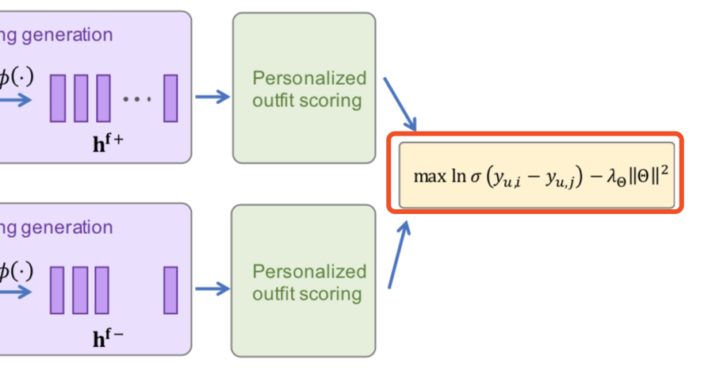
Parameter Learning
Triplet loss
Bayesian Personalized Ranking

Slide 9
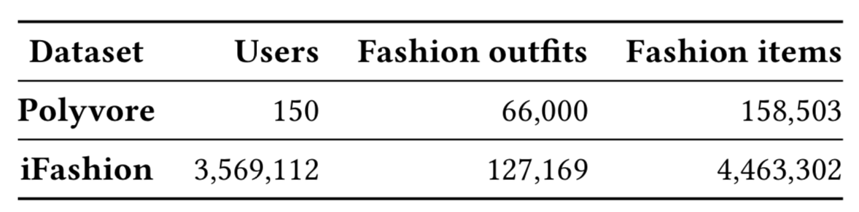
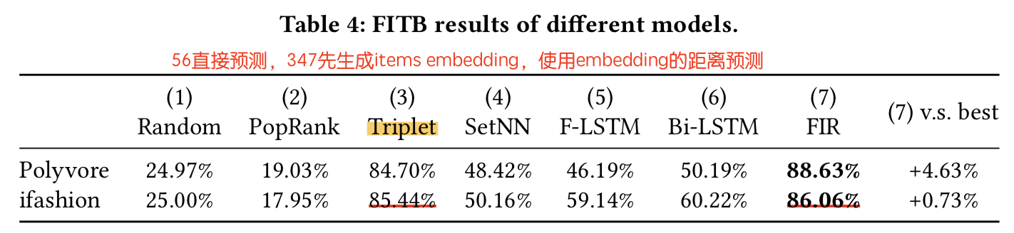
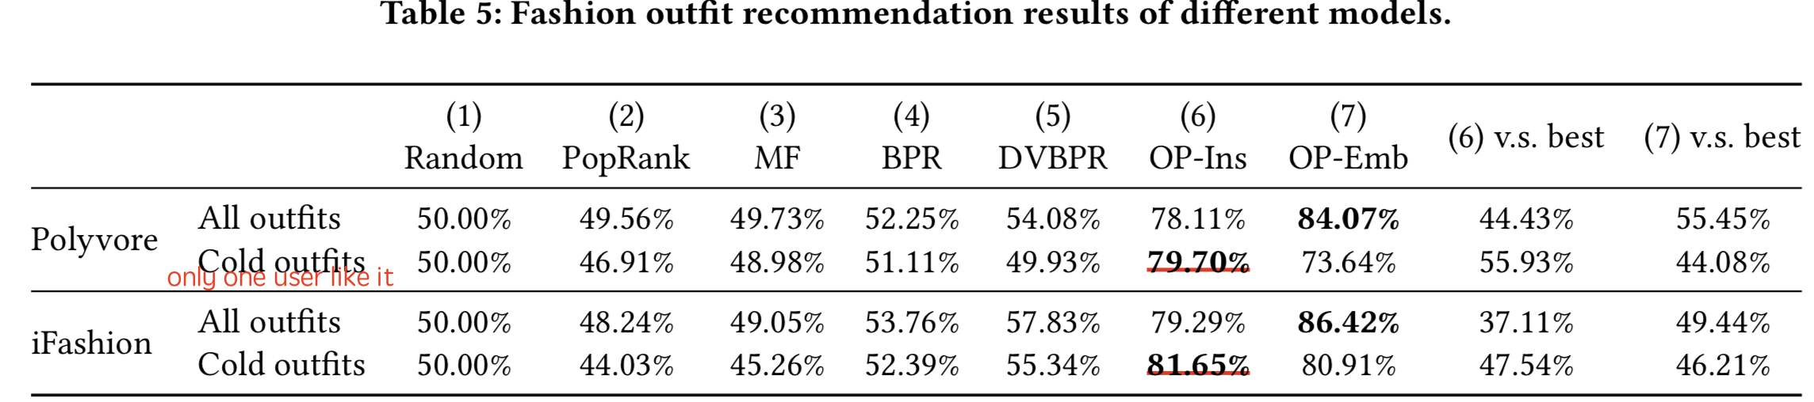
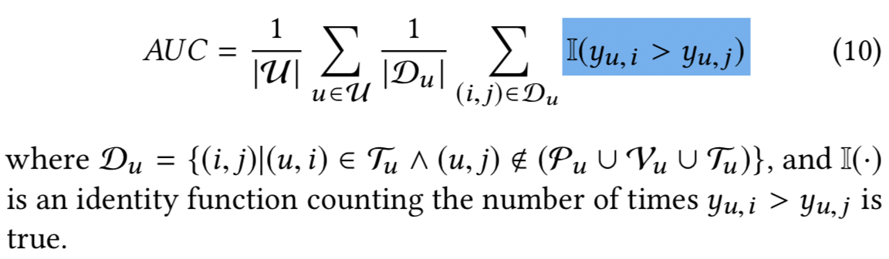
EVALUATION

Slide 10
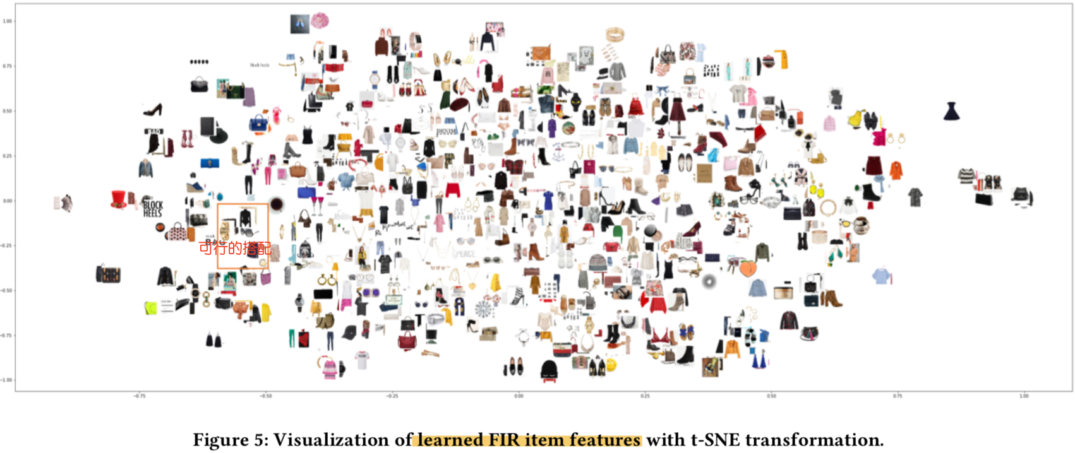
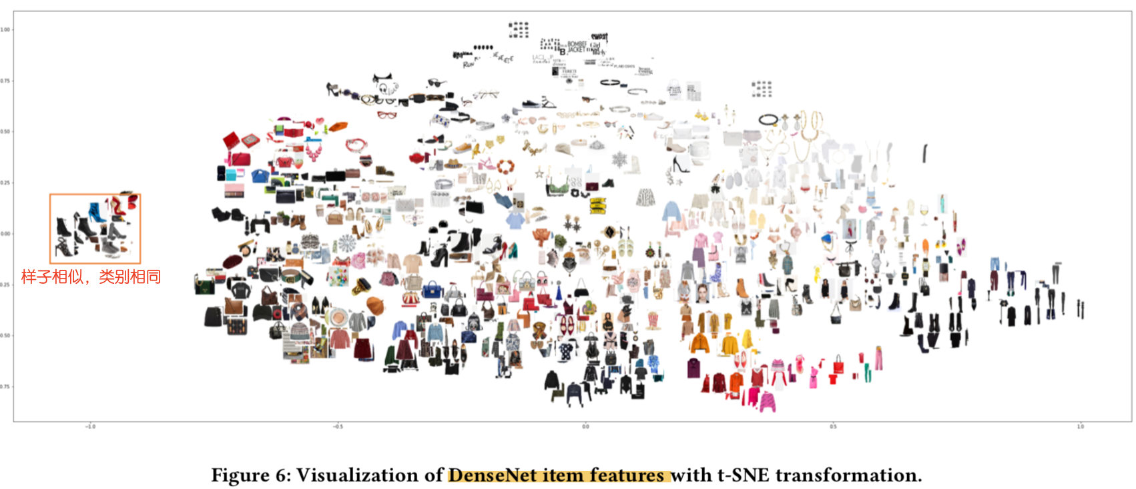
OUTFITNET APPLICATIONS-1.Fashion Item Embedding

Slide 11
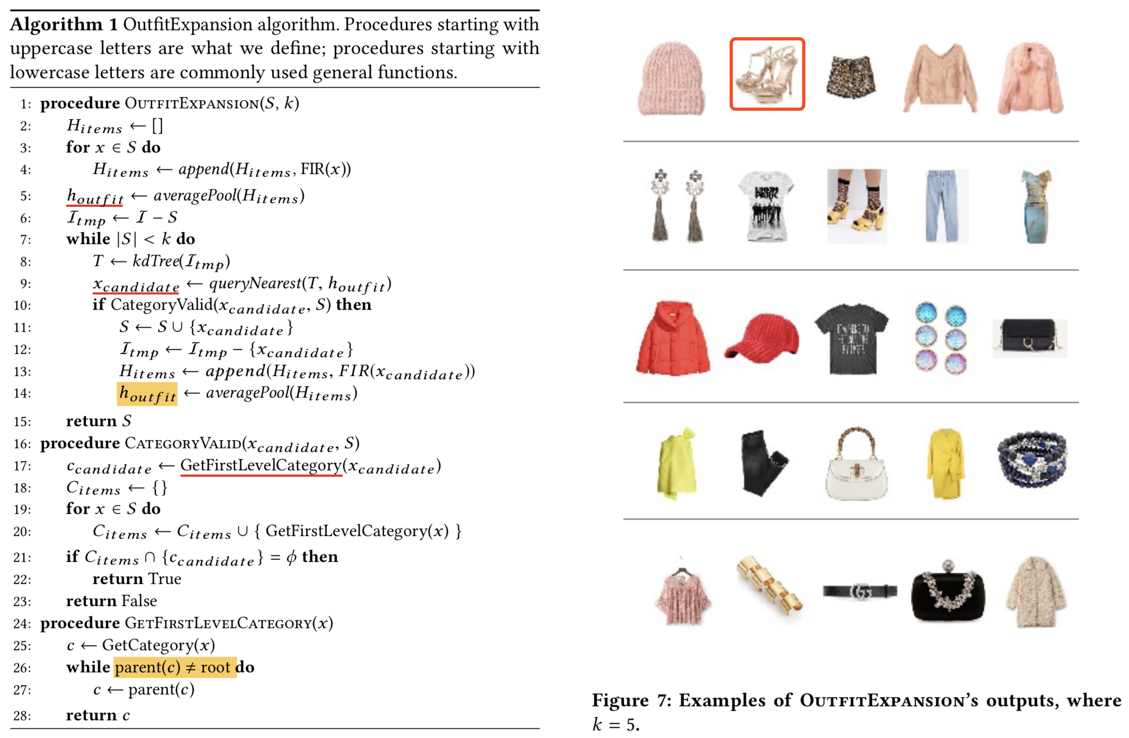
OUTFITNET APPLICATIONS-2.Fashion outfit Expansion

Slide 12
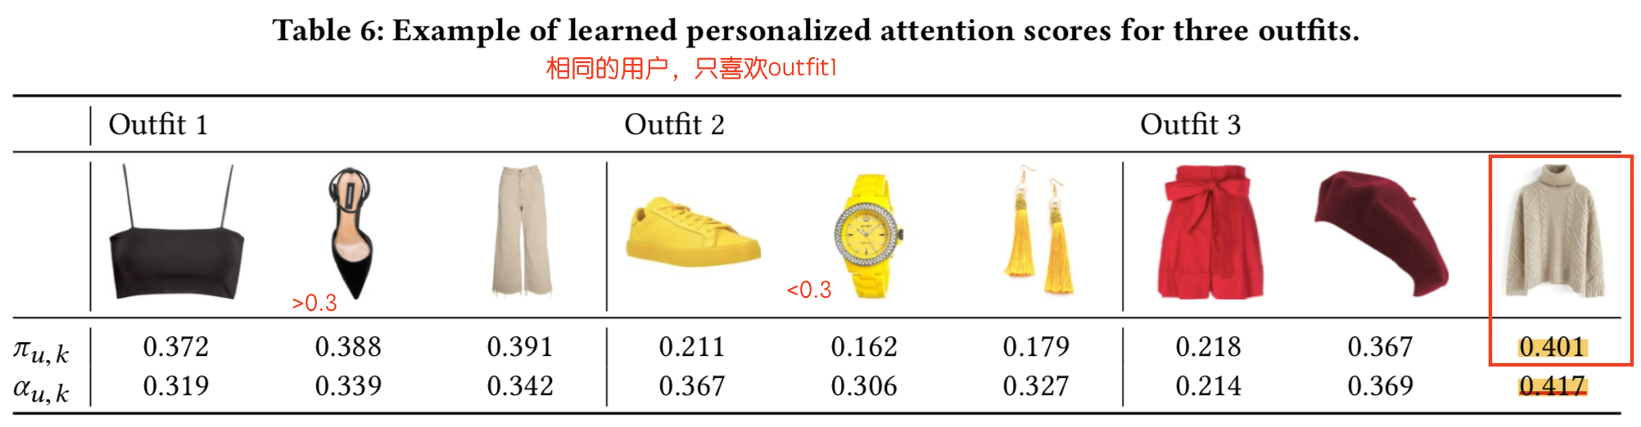
OUTFITNET APPLICATIONS-3. Personalized Fashion Outfit Attention

Slide 13
IDEA
MIL： enables us to learn not only the users’ preferences towards fashion outfits (labeled in the data) but also their preferences towards fashion clothing items (not labeled in the data)
personalized attention layer ： captures the users’ personal emphasis on each fashion item in fashion outfits when assessing their preference for the whole fashion outfit ensemble.

